Slide 1
p1RCC Genomic Hackathon Team Express Force
Sofia Medina, Amrit Virdee, Nikhil Balajil, Yuri Bendana, and Maricris Macabeo
Salesforce; May 20, 2018

Slide 2
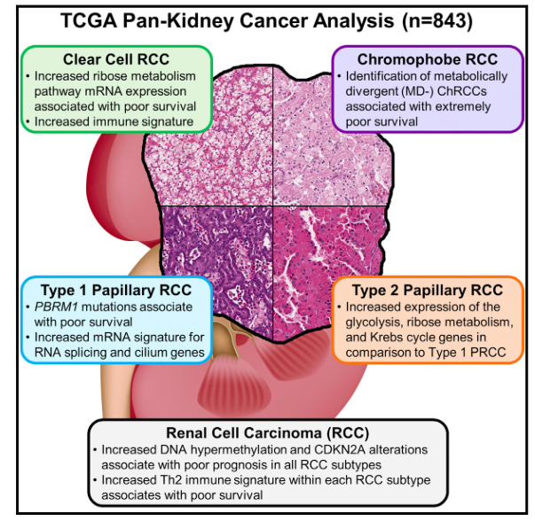
Introduction
p1RCC
Accounts for 15%-20% of RCC
Gain of chromosomes 7 and 17
Goal:
To provide candidate biomarkers for pRCC.
PMID: 29617669

Slide 3

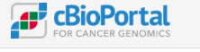


Methods
Mutated in >0.99% of patients + Co-expressed with pRCC (Plouhinec et al. Plos Biology)
Collaborative filtering using probability matrix factorization
Notes:
Kidney Renal Papillary Cell Carcinoma (TCGA, PanCancer Atlas) – mutated in >0.99% of patients +
Co-expressed with pRCC Plouhinect et al.
REFS
https://www.nature.com/articles/nature12222
https://www.ncbi.nlm.nih.gov/pmc/articles/PMC4906613/

Slide 4
Result
Normal
C7 and C17
2014 Genes
COSMIC and TCGA
1256 genes
COSMIC and TCGA
140 Genes
Notes:
16,384 protein coding genes

Slide 5
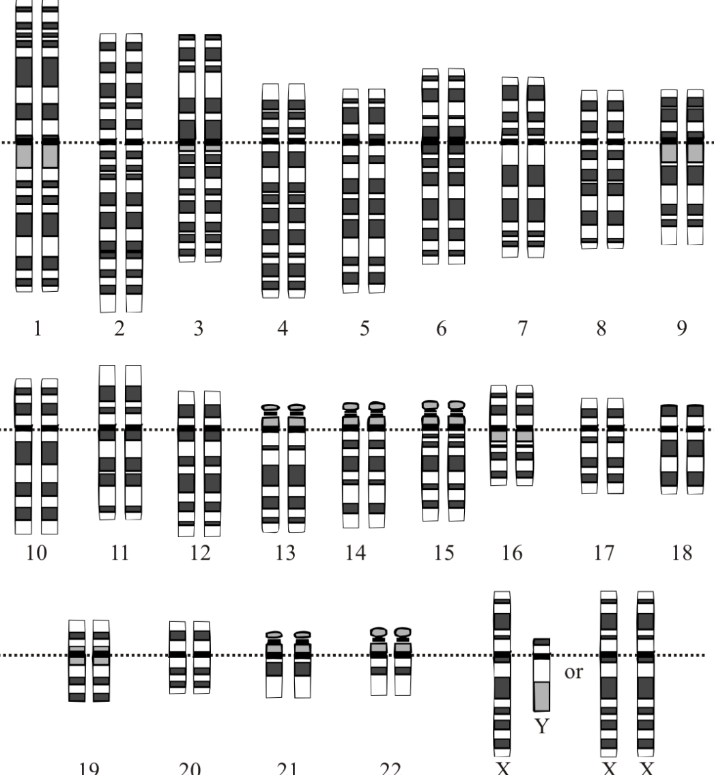
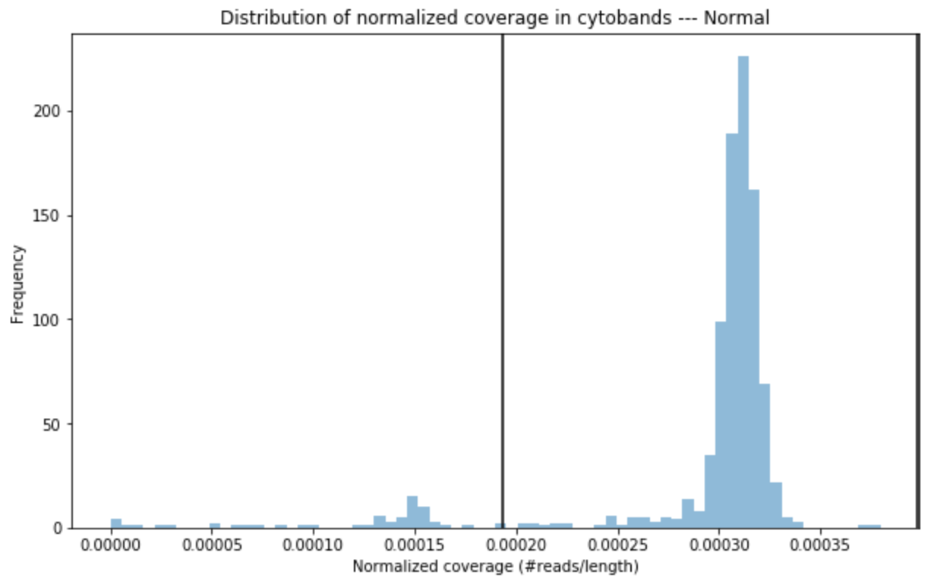
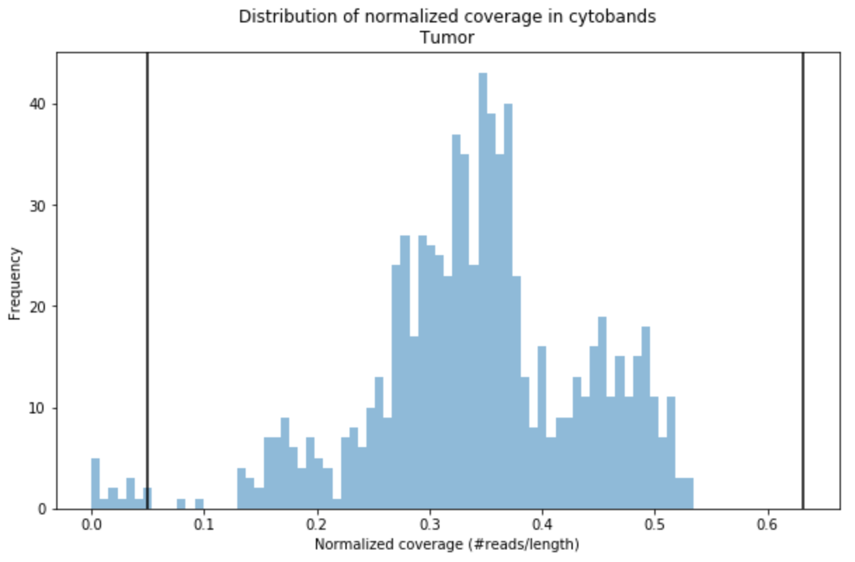
Normalized read coverage
Blood vs Tumor
X and Y
chromosomes
chr1.q12

Slide 6
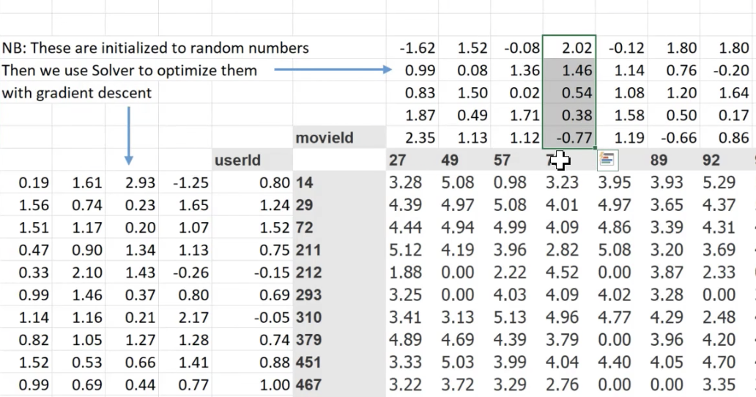
Netflix for genes
Sample ID vs Gene matrix table
Entity Embeddings
Dimensionality reduction

Slide 7
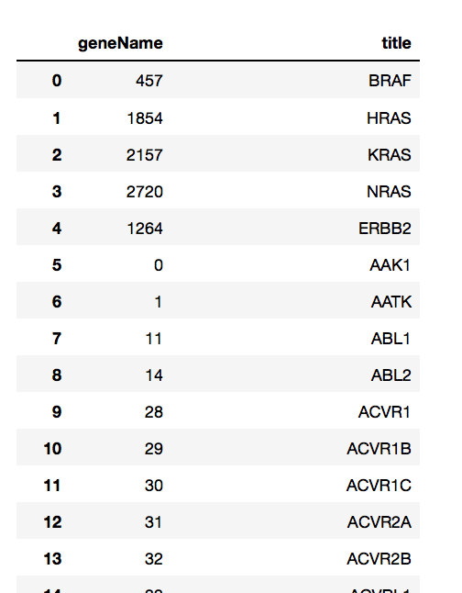
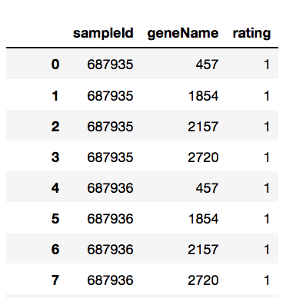
Netflix for genes
COSMIC dataset (Primary Site: kidney)

Slide 8
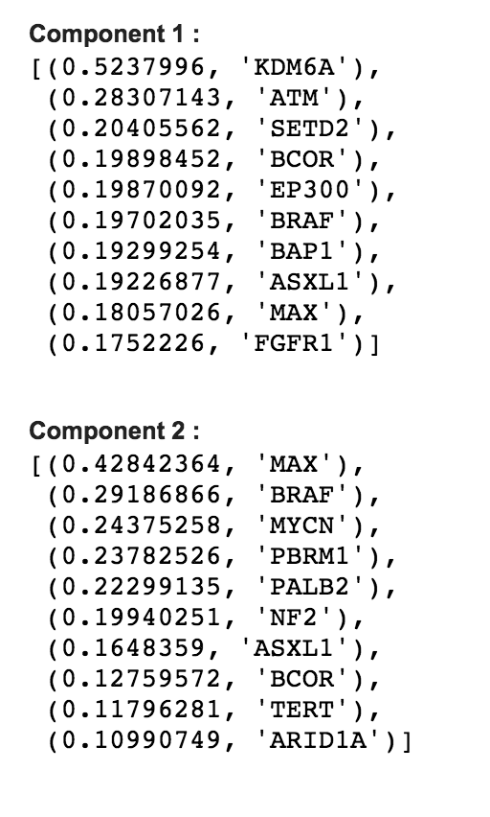
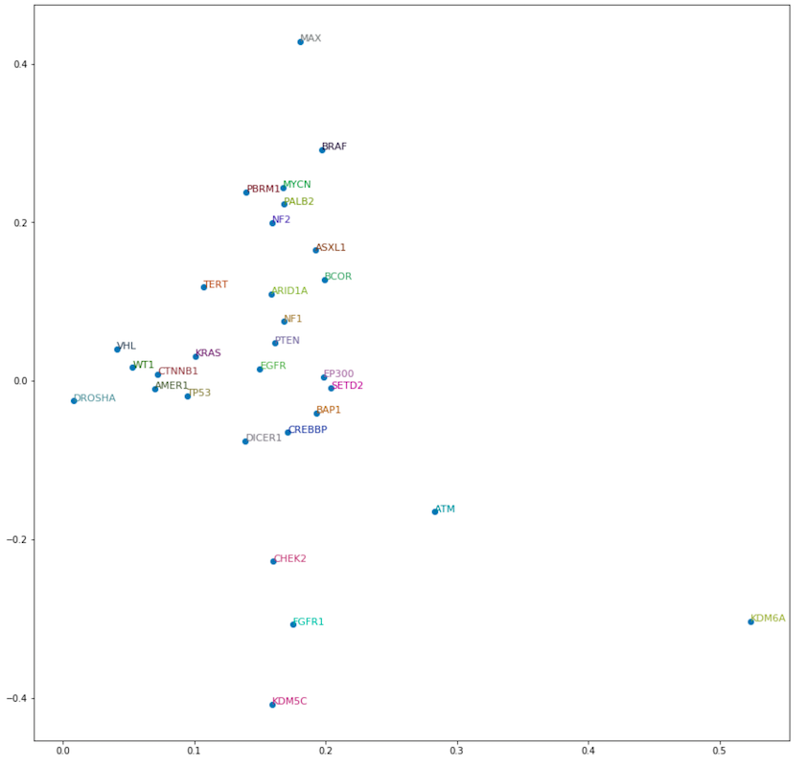
Netflix for Genes
Results

Slide 9
Reference
Special thanks to Sean Davis

